Slide 1
Systems Theory (von Bertalanffy, 1968)
WHOLE → Interacting Parts → soc or bio construct
Cannot understand ppl in isolat. from one another

Slide 2
Families as Systems
Made of interrelated elements/objectives
Each element has
Exhibit
Have
Interdepend. on one another
Rel’s b/w elements function as such
ALL THIS TOGETHER FORMS A

Slide 3
Family Systems Theory: The Elements (Bowen, 1966)
Subsystems (e.g., marital, parent-child, sibling)
Smaller units w/i larger system
Share charac’s of larger system, BUT…
Each type = (norms, roles, behav’s, expectat’s)

Slide 4
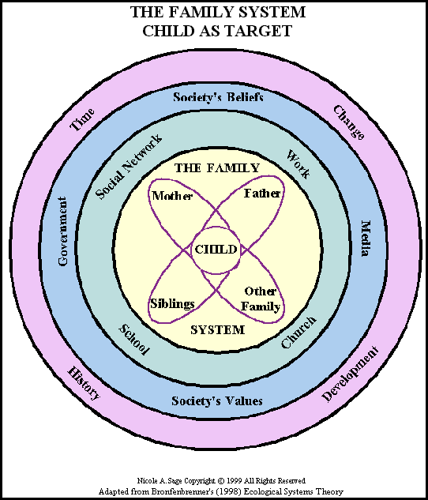
Family Systems Theory (Bowen, 1966)
Interconnected/Interdependent
We’re NOT isolated indiv’s
Set of ppl related by

Slide 5
Family System Features: Patterns
develop
Reliable: &
Comprised of Roles & Rules
Power distrib’s – shift w/ needs
Ideal → reliable, predictable patterns
Decision-making
Conflict resolution

Slide 6
Family System Features
Constant pull on systm to
Systm seeks continual
feedback loop
info that returns systm to pre-set level reduc. deviat
ALSO constant adaptation (need for change) - feedback loop

Slide 7
Cycle of Family Systems
Always wonder…
How get in cycle? Who starts?
Family systems thry view:
chicken/egg? Impossible answer b/c…
BOTH patterns cause OTHER
Each member’s behav. caused by (affects) & causes (effects) others’ behav’s

Slide 8
But… Family Systems are !

Slide 9
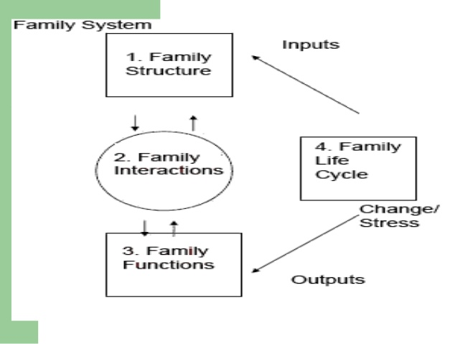
COMMUNICATION BOUNDARIES!
Continuum: Open to Closed (same as boundary permeability)

